Slide 1



CPython, Grumpy, PyPy
When, How, Why?

Slide 2

About Me
Itay Weiss
27 Years -
Alive
9 Years -
Software Developer
7 Years -
Army Intelligence
2 Years -
Iguazio
0.583 Years -

Slide 3
Python and CPython
CPython ≠ Python
CPython = A Language Engine
Python = Programming Language
Notes:
CPython is a Distinction between the implementation of the language engine from the Python programming language itself.
In Python-the-language development uses CPython as the base, other implementations follow.
in theory, a python script could be run using any of the implementations, and the results of running the script should be the same.

Slide 4
Python and CPython
CPython:
Is used by the majority of developers and users.
Compiles your python code into bytecode (transparently) and interprets that bytecode in an evaluation loop.
Performance is mainly limited by the GIL
Notes:
We’re going to talk about that theory.

Slide 5
GIL (Global Interpreter Lock)
A binary semaphore that prevents multiple native threads from executing Python bytecodes at once.
Must be held by the current thread before it can safely access Python objects.
GIL ≠ Mutex
Notes:
Poor man's version of thread safety.
Mutual Exclusion semaphores are used to protect shared resources (data structure, file, etc..).
A Binary semaphore should be used for Synchronization.
A set of "free threading" patches to CPython was submitted by Greg Stein, which effectively replaced GIL with fine-grained locking. However the patches were rejected due to the execution overhead they introduced into single-process code.

Slide 6
GIL (Global Interpreter Lock)
In order to emulate concurrency of execution, the interpreter regularly tries to switch threads (sys.setswitchinterval).
Python 2.x

Slide 7
GIL (Global Interpreter Lock)
The waiting thread waits until a timeout (By default TIMEOUT is 5 milliseconds, but it can be changed).
Python 3.2<
Notes:
A new GIL was written in cpython 3.2 by Antoine Pitrou

Slide 8
Simple Solution
Notes:
Don't delve into it

Slide 9
MultiProcessing
MultiThreading
PROS Code is usually straightforward Takes advantage of multiple CPUs & cores Avoids GIL limitations for CPython (basically each process has it’s own GIL) Child processes are interruptible/killable | PROS Shared memory Low memory footprint
CONS Separate memory space Costly to run a huge number of processes Costly to create and destroy processes frequently IPC a little more complicated with more overhead Larger memory footprint | CONS CPython - subject to the GIL Code is usually harder to understand and to get right - the potential for race conditions increases dramatically
Notes:
I know that last one (MultiThreading) is subjected to personal preference

Slide 10
Not So Simple Solution
Notes:
Don't delve into it

Slide 11
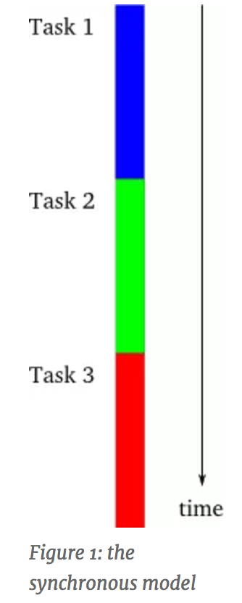
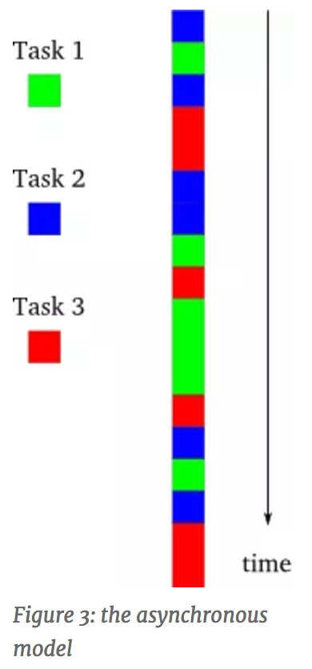
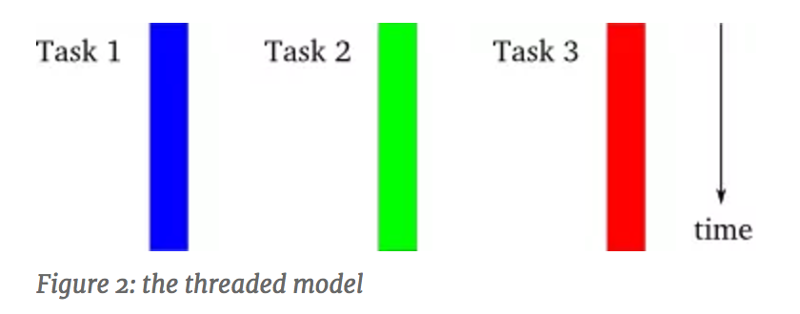
Twisted/async.io (Asynchronous Programming/Event driven programing)

Slide 12
When Should I Use CPython
GUI applications
Network servers
Notes:
Network server spends most of its time reading packets off the network.
GUI app spends most of its time waiting for user events

Slide 13
Demo
GIL
Notes:
Don't delve into it

Slide 14
PyPy
Supports all of the core language (passing Python test suite)
Supports most of the commonly used Python standard library modules (just check if it imports. If it imports, it should work):
__builtin__, __pypy__, _ast, _cffi_backend, _codecs, _collections, _continuation, _csv, _file, _hashlib, _io, _locale, _lsprof, _md5, _minimal_curses, _multibytecodec, _multiprocessing, _numpypy, _pickle_support, _pypyjson, _random, _rawffi, _sha, _socket, _sre, _ssl, _struct, _testing, _warnings, _weakref, array, binascii, bz2, cStringIO, cmath, cppyy, cpyext, crypt, errno, exceptions, fcntl, gc, imp, itertools, marshal, math, mmap, operator, parser, posix, pwd, pyexpat, pypyjit, select, signal, symbol, sys, termios, thread, time, token, unicodedata, zipimport, zlib
Built using the RPython language that was co-developed with it:
A framework for producing implementations of dynamic languages (like python)
Able to automatically generate a Just-in-Time compiler for any dynamic language
Implements a JIT compiler in Python.
Support for Stackless and Lightweight concurrent programming (Greenlets).
Notes:
All python standard library modules written in pure python works (cPickle, sqlite3)

Slide 15
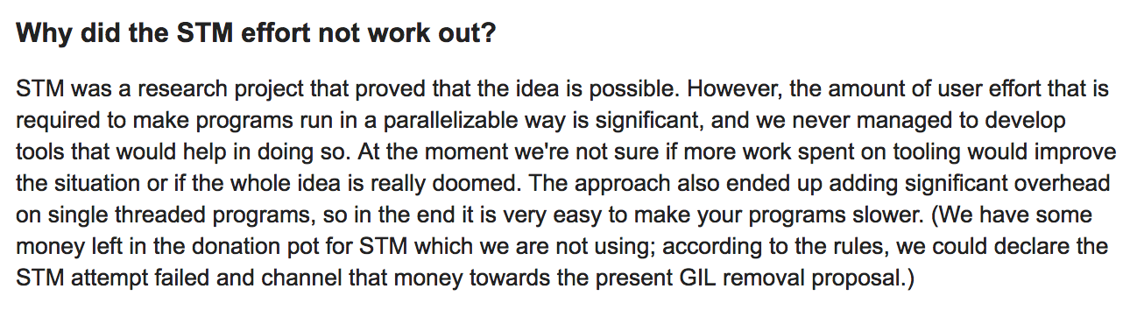
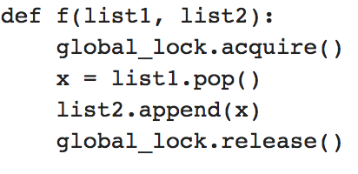
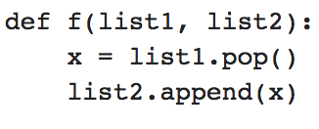
How Are PyPy Getting Rid Of The GIL
How PyPy Failed Getting Rid Of The GIL

Slide 16
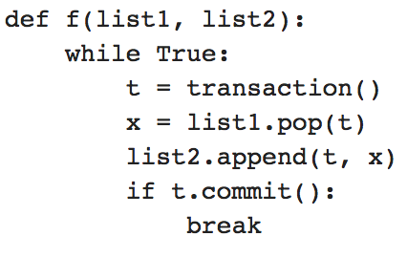
Software Transactional Memory

Slide 17
JIT(Just In Time)
Done during execution (runtime).
Continuously analyses the code being executed and identifies parts of the code where the speedup gained from compilation would outweigh the overhead of compiling that code
In theory JIT compilation can yield faster execution than static compilation.
Notes:
Also known as dynamic translation

Slide 18
Demo
Performance + How to use PyPy
Notes:
Don't delve into it

Slide 19
When Should I Use PyPy
Long running processes
When running mostly Python code.
Notes:
JIT needs to “Warm up”.
Doesn’t work well with scipy, Pandas
pypy -m pip install --user scipy

Slide 20
Grumpy
Google has YouTube which is:
Written In CPython (2.7)
Serves millions of requests per second
Google decides to Implement an alternative runtime optimized for real-time serving.
Google decides to use Go.
Grumpy was born!
Notes:
I do not work for google and I’m guessing some of it and “Compiling” data from the documentation and google blog.
Using go which is also a google project.

Slide 21
Grumpy
Python to Go source code transcompiler and runtime.
Grumpy has no VM.
Has no GIL.
Uses Go’s garbage collection instead of counting references.
Uses Go’s goroutines
No support for C extension modules.
Notes:
Needed to support a large existing Python codebase.
A huge advantage.
GoRoutines:
Goroutines have a faster startup time than threads
Goroutines are multiplexed onto a small number of OS threads, rather than a 1:1 mapping.
Goroutines have growable segmented stacks.
This means that Grumpy cannot leverage the wealth of existing Python C extensions

Slide 22
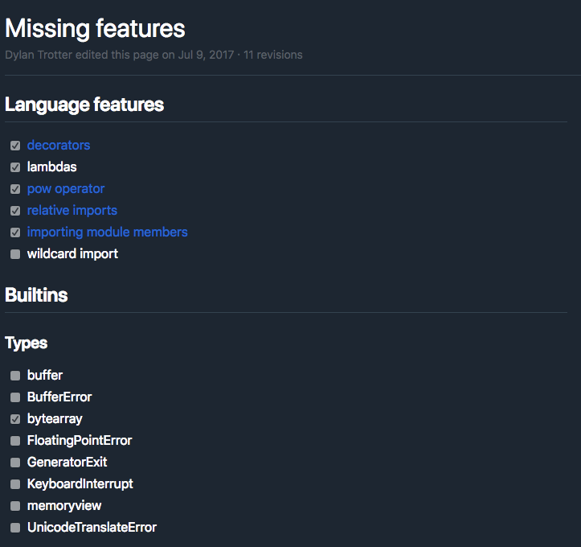
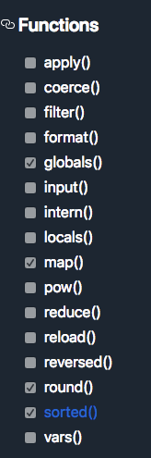
Grumpy Features
Notes:
It is only an assumption but a probable one that google is implementing grumpy according to their own needs specifically to one day support and run YouTube.

Slide 23
Demo
Performance + How to use Grumpy
Notes:
Don't delve into it

Slide 24
So which one has the best performance???
Dict Operations
 | pypy 2.7 | pypy 3.6 | python 2.7 | python 3.6 | grumpy | Max | Min
BenchmarkDictCreate | 1450018991 | 1146059661 | 9150119.157 | 9046784.877 | 1695006.364 | pypy 2.7 | grumpy
BenchmarkDictCreateFunc | 1503687375 | 4329709.169 | 3932658.568 | 3374312.332 | 1020829.856 | pypy 2.7 | grumpy
BenchmarkDictGetItem | 140226856.3 | 124192851.8 | 31829670.34 | 21461999.59 | 10997887.58 | pypy 2.7 | grumpy
BenchmarkDictSetItem | 95185928.29 | 99022084.33 | 24672325.76 | 19936729.46 | 5331109.432 | pypy 3.6 | grumpy
BenchmarkDictStringOnlyGetItem | 126787806.7 | 129258907.5 | 33041546.44 | 24173192.88 | 11138902.38 | pypy 3.6 | grumpy
BenchmarkDictStringOnlySetItem | 90706527.51 | 91076428.76 | 26744788.29 | 20688567.85 | 5621035.744 | pypy 3.6 | grumpy
BenchmarkHashStrCached | 1146345922 | 1119756541 | 30558516.86 | 14645639.98 | 11977268.42 | pypy 2.7 | grumpy
Notes:
Needed to support a large existing Python codebase.
A huge advantage.
GoRoutines:
Goroutines have a faster startup time than threads
Goroutines are multiplexed onto a small number of OS threads, rather than a 1:1 mapping.
Goroutines have growable segmented stacks.
This means that Grumpy cannot leverage the wealth of existing Python C extensions

Slide 25
Do Some Thinking

Slide 26
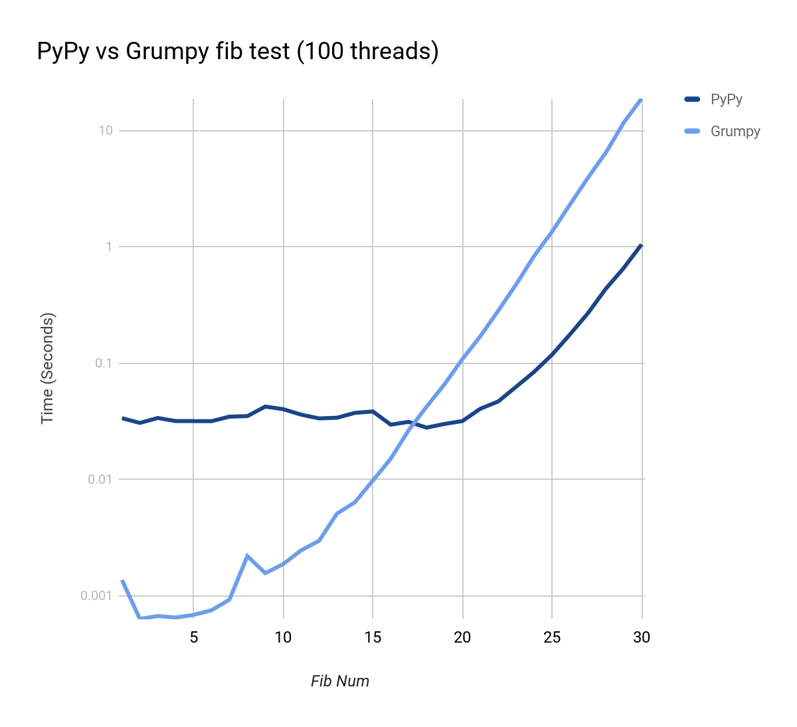
It All Comes Down To This

Slide 27
When Should I Use Grumpy
When you’re using a lot of threads, each executing a very small task.
When you need to use any of the go libraries.
Notes:
JIT needs to “Warm up”.
Doesn’t work well with scipy, Pandas
pypy -m pip install --user scipy

Slide 28
Basic Comparison
CPython
PyPy
Grumpy
The reference implementation of Python
Written in C
compiles Python code to intermediate bytecode which is then interpreted by a virtual machine
Supports all of the core language (passing Python test suite)
supports most of the commonly used Python standard library modules
Implements a JIT compiler in Python
Python to Go source code transcompiler.
Grumpy has no VM.
Uses Go’s garbage collection instead of counting references.

Slide 29
Performance Comparison
GIL
JIT
Go
A binary semaphore that prevents multiple native threads from executing Python bytecodes at once.
Must be held by the current thread before it can safely access Python objects
Done during execution (runtime).
In theory JIT compilation can yield faster execution than static compilation.
Has no GIL.
Statically compiled.
Uses Go’s garbage collection instead of counting references.
Uses Go’s goroutines

Slide 30
Thanks
David Beazley (http://www.dabeaz.com/) - https://www.youtube.com/watch?v=ph374fJqFPE
Dave Peticolas - http://krondo.com/an-introduction-to-asynchronous-programming-and-twisted/
Emmanuel Klinger - http://emmanuel-klinger.net/python-100-times-faster-than-grumpy.html
PyPy blog: https://morepypy.blogspot.co.il/2011/06/global-interpreter-lock-or-how-to-kill.html
Stackoverflow
https://stackoverflow.com/questions/18946662/why-shouldnt-i-use-pypy-over-cpython-if-pypy-is-6-3-times-faster
https://stackoverflow.com/questions/3044580/multiprocessing-vs-threading-python
https://stackoverflow.com/questions/62814/difference-between-binary-semaphore-and-mutex

Slide 31
More Questions
me@itayweiss.tech

